Slide 1

GASTROENTERITIS AND DEHYDRATION IN CHILDREN WITHOUT SEVERE ACUTE MALNUTRITION
Prof Grace Irimu PhD, MMed, MBChB
Paediatrician, Paediatric Nephrologist, Public Health Specialist

Slide 2
Appropriate guidelines should be used in management of Children with the following co-morbidities
Severe acute malnutrition
Neonates
Hypernatremia dehydration
Hyponatraemic dehydration
Cardiac diseases
Kidney diseases

Slide 3
Objectives
To understand aetiology of diarrhoea
To understand the link between classification and fluid plans
To explain fluid plans
To highlight additional treatments

Slide 4
Aetiology of diarrhoea (1)
Gastroenteritis of the gastro-intestinal tract caused by :
Bacteria
Enterotoxigenic Escherichia coli
Shigella dysenteriae ( increase with age)
Vibrio cholera
Cryptosporidium species
Campylobacter jejuni
Viral
Rota virus (highest in infancy)
Norovirus Norwalk-like virus
Adenovirus
Parasites.
Entamoeba histolytica
(Giardia Lamblia appears to be protective in acute diarrhoea in community studies)
Notes:
Norovirus (Norwalk-like virus, calicivirus )
‹#›

Slide 5
Aetiology of diarrhoea
Person-to-person contact
Rota virus
Shigella,
E.coli
Campylobacter jejuni
Emoeba
Food borne out-breaks
In high income countries – salmonella, E.coli, staph aureus
In low income countries – salmonella, shigella, E.coli
Water-borne outbreaks
E.coli
Cryptosporidium species
Campylobacter jejuni
Noroviruses
Shigella species
Giardia
Vibrio cholera
Notes:
Person to person contact for entomopathogens that are infectious in a small inoculum
‹#›

Slide 6
Commonest cause diarrhoea/dehydration
Watery diarrhoea
Rotavirus – commonest in infants
Cryptosporidium species (regardless of HIV status )
Shigella
Heat stable (ST)-Enterotoxigenic E.coli
Typical enteropathogenic E.coli
Bloody diarrhoea – shigella
Diarrhoea epidemics – V. cholera

Slide 7
Pathogenesis
Non inflammatory diarrhoea – caused by :
enterotoxin production
Destruction of villus cells by viruses
Adherence by parasites
Adherence by bacteria
Inflammatory diarrhoea
Bacteria directly invade the intestine
Bacteria produce cytotoxins causing fluid, protein and cells leak to the intestinal lumen
Non inflammatory diarrhoea Hypersecretion of fluid and electrolytes | Inflammatory diarrhoea Reduced absorption of sodium and chloride
Notes:
Non- inflammatory – adherence to the enterocytes causing hypersecretion of fluid and electrolytes
Inflammatory diarrhoea - may cause extensive histologic damage )eg shigella,salmonella – cause reduced absorption of sodium and chloride
Predominantly inflammatory diarrhoea is seen in response to some bacterial pathogens, such as Clostridium difficile, which is the most common cause of nosocomial antibiotic-associated diarrhoea. Also seen in autoimmune diseases such as IBD and coeliac disease
‹#›

Slide 8
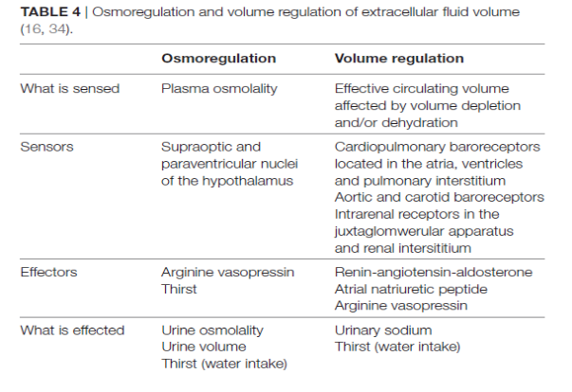
Front. Pediatr. 6:28. doi: 10.3389/fped.2018.00028

Slide 9
Clinical feature
Diarrhoea
( Ask watery, bloody, mucoid)
Vomiting
Nausea
Abdominal cramps
+/- fever
Incubation period – variable
Rotavirus, E.coli Salmonella – 1-3days
V Cholera 24-48hours
Staph aureus – 1-6hours
Location of infection – proximal small bowel= watery, no faecal leucocytes , colonic = dysentery + faecal PMN
Notes:
Mucoid diarrhoea – amoeba
Bloody – Shigella, Shiga-toxin producing E coli, campylobacter, Amoeba
Location of infection – proximal small bowel= watery, no faecal leucocytes , colonic = dysentery + faecal PMN
‹#›

Slide 10
Declining mortality, still a lot to be done
No significant change in incidence of diarrhoea
But the mortality has declined due to
Vaccination esp Rotavirus Vaccine
Better case management at home and hospital-based (ORS)
Improved nutritional management of child with diarrhoea
Effective case management guidelines available but mortality still high in low and middle countries due to:
Delayed care seeking (home & community)
Delay in instituting correct care to prevent and treat dehydration (home, community and hospital based)
Suboptimal care (promotive, prevention and management of diarrhoea/dehydration)
Odds of dying is 8.5 fold for severe/some dehydration
>85% of deaths occur in first 2 years of life

Slide 11
Clinical evaluation
History
Obtain appropriate exposure history
Assess degree of dehydration
Mental status – AVPU
Quality of pulses
Capillary refil time
Temperature of extremities and gradient
Ability to drink – eagerness to drink
Sunken eyes
Skin turgor
Also
Assess heart rate and breathing
Unreliable signs/difficulty to assess Mouth and tongue - dry Eyes - dry Tears Urine output

Slide 12
Principles of acute diarrhoea management
Increased fluids
Continued feeding
Zinc supplementation
Rational use of antibiotics

Slide 13
Treatment of dehydration
Assess correctly &adequately
Classify the severity of dehydration
Stabilize hemodynamic status ie shock
Correct dehydration
Give maintenance fluids,
Replace on going loses.
Notes:
Ask for
duration
Is diarrhoea bloody?
Assess and classify the severity of dehydration.
The survival of a child with severe volume depletion at the emergency department depends on the competency of the first responder to recognize and promptly treat hypovolemic shock.
Treat dehydration
‹#›

Slide 14
How severe is the dehydration due to diarrhoea?
Hpovolaemic shock
(Severely impaired circulation)
All of the four (4) below are present:
Not alert, AVPU < A
Weak or absent peripheral pulse
Cold periphery & temp gradient
Capillary refill > 3 secs
PLUS
sunken eyes and
slow skin pinch > 2secs
Ringer’s 20mls/kg bolus max 2. then Plan C part 2
Y
Transfuse urgently if Hb <5g/dl
Treat hypoglycaemia
Notes:
‹#›
In most training on dehydration shock is not mentioned….but it is the condition that precedes death and we need to know how to manage it!
First look for severely impaired circulation / shock (shock is sometimes a confusing word including ‘septic shock’ and even a fright!) – dehydration may cause severely impaired circulation and if it does the management is specific to this immediate problem but then it is important to plan specific dehydration therapy.

Slide 15
Management of diarrhoea / dehydration with severely impaired circulation = ‘hypovolaemic shock’
Observe, SSS, A & B , start oxygen, then if signs of severely impaired circulation & dehydration = Hypovolaemic Shock
Exclude Sever Acute Malnutrition
Establish IV /IO access.
20mls/kg Ringer’s bolus (<15min)
Reassess ABC, give max 2 boluses, then
Plan C step 2

Slide 16
How severe is the dehydration due to diarrhoea?
Not alert, AVPU < A
Weak or absent peripheral pulse
Cold periphery and temperature gradient
Capillary refill > 3 secs
PLUS sunken eyes and skin pinch > 2 secs
Y
Severely Impaired Circulation ‘Hypovolaemic Shock’
N
Severe dehydration
AVPU < A plus / unable to drink Plus
Sunken Eyes
Skin pinch ≥ 2 secs
Severe Dehydration
Plan C
Y
Notes:
‹#›
If the child does not have Severely Impaired Circulation (not shocked) then are they severely dehydrated?
The best signs of dehydration are sunken eyes and a very slow return of skin pinch. If these are present and the pulse is easy to feel (even if it is very fast) and the child cannot drink (which means they are not likely to be alert) then iv fluids are indicated for severe dehydration.
If the child can drink then oral / ngt rehydration may be preferred as safer and provides glucose.
The capillary refilling is also likely to be prolonged in these patients and they are likely to have other signs of dehydration but sunken eyes, long skin pinch and inability to drink are the important signs that indicate a need for iv therapy.

Slide 17
Treatment of severe dehydration
 | Step 1* | 30 mls / kg over 30 mins
 | Step 2 | 70 mls / kg over 2.5 hours
 | NGT rehydration-120ml/kg ORS over 6hours can be used instead of steps 1 and 2 Re-assess at least hourly and after 3-6hrs, reclassify as severe, some or no dehydration and treat accordingly
.
Give 5ml/kg of ORS once the child can drink
* Go to step 2 if child has received bolus for shock
Notes:
‹#›
Severe dehydration is treated in two phases, a rapid ‘rescue’ phase, step 1 and a less rapid replacement phase, step 2.
Young children should have fluids given more slowly.
The ideal fluid to give in Ringer’s as it contains Potassium and body potassium is often depleted in diarrhoea. (The lactate is not a risk although most severely dehydrated children will be acidotic the lactate is metabolised to produce HCO3-).
It is critical that after receiving these fluids children are re-assessed. You CANNOT write a 24 hour fluid plan for a severely dehydrated child and walk off!
When the child is re-assessed they are re-classified as severe, some or no-dehydration and treated appropriately – there is no need to continue iv fluids if the child is drinking.
NOTE giving these high volumes of fluids to a child who is not severely dehydrated may be dangerous……it is very important that people classify severe dehydration correctly.
Give oral fluids as soon as drinking, provides some glucose and more potassium
This is equivalent to correcting 10% dehydration in 3 – 6 hours

Slide 18
IV Fluid replacement
Replacement fluids should be similar to body fluids
Fluid deficit
All concentrations are in mmol/l | Na⁺ | K⁺
Ringer’s Lactate (Hartmann’s) | 130 | 5.4
Existing fluid
Na⁺, 140 mmol/l
K⁺, 4.5 mmol/l
But the iv fluids don’t contain glucose....
Notes:
‹#›
Ask audience to imagine that the red box represents the fluid remaining in the circulation and extracellular spaces with a normal sodium concentration. The whole area represents what the normal fluid volume should be and the blue area therefore the current deficit.
Then ask what will happen to the average sodium concentration if we replace the fluid deficit with a low sodium content fluid – for example a fluid with a sodium concentration only half that of plasma? Thus imagine filling up the blue area with half strength Darrow’s (Na concentration about 60mmol/l)
They should answer that the average sodium concentration, measured in the whole fluid space will go down even though sodium has been added to the body – because more water that sodium has been added the Na is now diluted.
Remind them that iv fluids do not contain glucose – note adding glucose is difficult as the speed of administration needs to be taken into consideration, It is possibly dangerous to give too much glucose too quickly by infusing even 5% dextrose fast, it can cause an osmotic diuresis worsening dehydration!

Slide 19
How severe is the dehydration due to diarrhoea?
Not alert, AVPU < A
Weak or absent peripheral pulse
Cold periphery and temperature gradient
Capillary refill > 3 secs
Severely Impaired Circulation ‘Hypovolaemic Shock’
Y
unable to drink or AVPU < A
plus:
Sunken Eyes
Skin pinch ≥ 2 secs?
Y
Severe Dehydration
Able to drink plus ≥ 2 of:
Sunken Eyes and / or
Skin pinch 1 - 2 secs
Restlessness / Irritability
Y
Some Dehydration
Notes:
‹#›
If a child can drink….even if you think they might not drink fast enough then we will classify them as some dehydration
The same signs are used for some dehydration but the skin pinch may return a little faster and they may be restless / irritable although they can drink. If they can drink even if they are a not obviously thirsty they can be resuscitated with oral or nasogastric ORS.
Refer to the BPP and emphasize on Plan A for diarrhoea with no dehydration

Slide 20
Some dehydration is best treated with ORS
Oral rehydration is associated with FEWER deaths and convulsions
ORS contains glucose and potassium
ORS can safely be given down an NG tube if needed
Very rarely an ileus (bowel stops working = absent sounds with distension) is a reason to stop oral fluids
Notes:
‹#›
1) reviews of the evidence in over 1500 children have demonstrated that ORS is just as effective as iv fluid resuscitation and probably safer even when there is vomiting (see Bellamere, 2004 and Fonseca, 2004).

Slide 21
Composition of low osmolality ORS
 | Mmol/l
Sodium | 75 | Replaces Na lost in stool
Chloride | 65
Glucose | 75 | Facilitates absorption of Na (and hence water) in the small intestine
Potassium | 20 | Replace K+ lost in stool
Citrate | 10 | Corrects acidosis
Total Osmolality | 245
ORS is based on the discovery that glucose greatly increases the patient's capacity to absorb salts and water.
More than 90% of the diarrhea diseases irrespective of the cause respond to ORS
Notes:
Na absorption is coupled with absorption of an organic solute ie glucose. Note that this mechanism of absorption of sodium is preserved in diarrhea even when the epithelia cells are damaged. ORT is based on the discovery that glucose greatly increases the patient's capacity to absorb salts and water. Glucose is 13.5g/l ie 1.3%
Advantages of the new ORS : The need for unscheduled supplemental IV therapy in children given this solution is reduced by 33%, reduces stool output by about 20% and the incidence of vomiting by about 30% - as compared to the standard ORS. Thus is safer– for the 4th Years don’t mention this- but for other people who have used the standard ORS – this may give them more confidence in use of ORS and to remember to prescribe.
‹#›

Slide 22
How severe is the dehydration?
Not alert, AVPU < A
Weak or absent peripheral pulse
Cold periphery and temperature gradient
Capillary refill > 3 secs
Severely Impaired Circulation ‘Hypovolaemic Shock’
Y
unable to drink / AVPU <A plus Sunken Eyes &
Skin pinch ≥ 2 secs?
Y
Severe Dehydration
Able to drink plus 2 or more of:
Sunken Eyes and / or
Skin pinch 1 - 2 secs
Restlessness / Irritability
Y
Some Dehydration
Y
Diarrhoea with no Dehydration
Not classified above?
Notes:
‹#›
If a child does not meet any of the dehydration classifications above then they have no significant dehyrdration even if they have lots of diarrhoea.

Slide 23
Why do we use these signs?
Severely Impaired Circulation caused by severe diarrhoea likely indicates Hypovolaemic Shock -requires immediate management
Ability to drink is an important indicator of severity. If they can drink then use oral or oral + ngt fluids.
Sunken Eyes and Skin Pinch are the most reliable signs of dehydration
Signs which work poorly include:
Dry mucous membranes
Absence of tears
Poor urine output

Slide 24
Prescribing ORS-Some Dehydration
75 mls / kg of ORS over 4 hours.
Continue breastfeeding as tolerated
After 4 hours reassess and reclassify;
Severe, Some or no dehydration?
Counseling the mother / caretaker?
What do you tell the mother of an 8kg child?
Notes:
‹#›
The recommended amount of ORS to give is in the slide.
After the first 4 hours therapy the child should be reassessed. Do they still have some dehydration? If they do the 75mls/kg over 4 hours should be repeated. If the situation has improved they can be advised to give 100mls ORS with every loose stool and offer the child as much fluid as they wish to take.
So ask the audience what they would tell the mother of an 8kg child with some dehydration?
You should get the response give 600mls of ORS in 4 hours (if they are awake).
But what does 600mls mean to a mother?

Slide 25
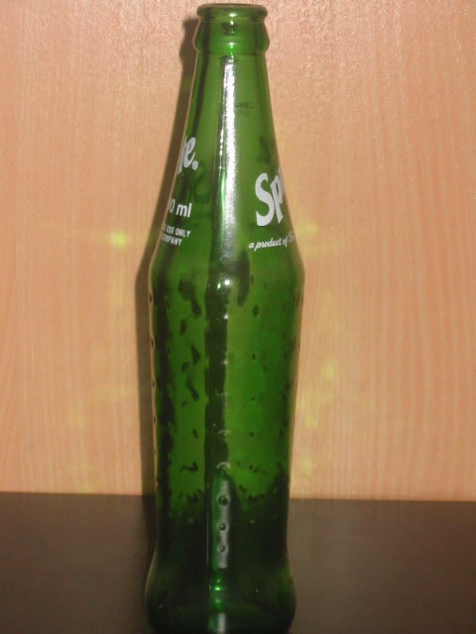
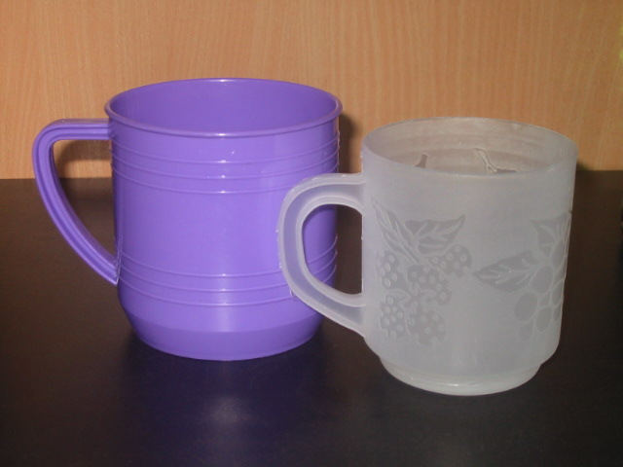
ORS in practice.
300 mls
200 mls
Notes:
‹#›
1) Large cups and soda bottles hold 300mls, small cups hold 200mls (beer bottles hold 500mls)

Slide 26
Prescribing ORS
75 mls / kg for an 8kg child?
600 mls in 4 hours
2 large cups / 2 soda bottles in 4 hours
3 small cups in 4 hours.
Notes:
‹#›
1) So to prescribe ORS and explain to the mother what her task is use something familiar.

Slide 27
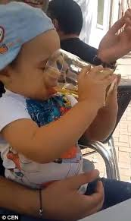
Prescribing ORS to prevent dehydration (Plan A)
After correction of dehydration
Give required feeds and fluids
In addition, ORS 10ml/kg for every loose stool
In a child with diarrhea and NO dehydration give usual foods (appropriate for nutritional status ) and fluids & breastfeeds more frequently PLUS
10ml/kg after every loose stool
Notes:
10ml/kg is the approximate fluid lost in a loose stool. ORS replaces all the electrolytes lost. This should be done the child is hydrated, diarrhea does not stop abruptly, so prevent further dehydration by replacing the on going looses. All children with diarrhea should therefore have Plan A. and all must have Zinc
Plan A should not be prescribed together with Plan B or C- Should be done once rehydration therapy is completed, ie when reassessed and no dehydration.
‹#›

Slide 28
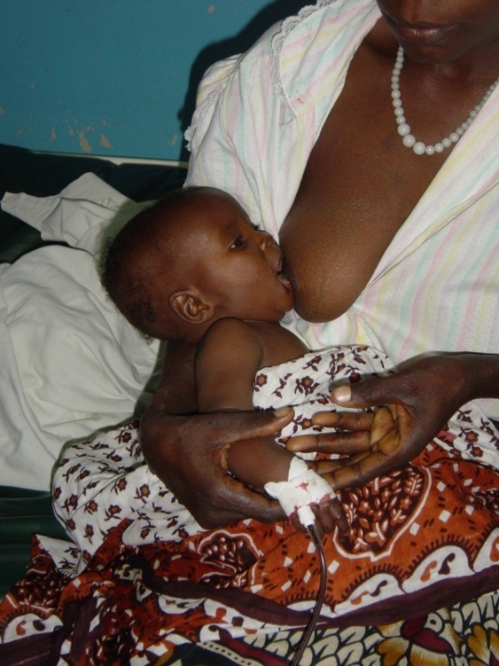
Vomiting and feeding?
Vomiting is NOT a contra-indication to oral rehydration
Careful counseling about, slow, steady administration of ORS is helpful.
Breast feeding and other forms of feeding can and should continue
There is no evidence of benefit from using half-strength feeds or gradual re-introduction of feeding.
Notes:
‹#›
Breast milk has important anti-infective properties and nutritional properties.
There is no evidence of any benefit of ‘re-grading’ or the slow introduction of feeding after diarrhoea, in fact this practice may promote malnutrition (see Murphy, 1998).

Slide 29
Role of Zinc
Modulating the host resistance to infectious agents
enhances the immune response, allowing for a better clearance of the pathogens
Reduces the risk, severity, and duration of diarrheal diseases.
improves the absorption of water and electrolytes
increases the levels of brush border enzymes
may shorten the duration of diarrhoea by around 10 hours,
improves regeneration of the intestinal epithelium
Zinc curtails the severity of the episode and prevent further occurrences in the ensuing 2 -3 months.
Diarrhea can lead to zinc deficiency and the resulting zinc deficiency worsen duration and severity of diarrhoea.
Zinc deficiency increase risk of diarrhoea mortality
Notes:
Ask the participants – what is the role of zinc?
Zinc improves cellular immunity and maintains gut mucosa. At the GI level zinc restores mucosa barrier integrity and the enterocyte brush border activity.
Use of zinc is however associated with increased incidence of vomiting. But the benefits outweigh this risk.
In children aged greater than six months with acute diarrhoea, zinc supplementation may shorten the duration of diarrhoea by around 10 hours, and probably reduces the number of children whose diarrhoea persists until day seven. In children with signs of moderate malnutrition the effect appears greater, reducing the duration of diarrhoea by around 27 hours. Cochrane Database Syst Rev. 2013 Jan 31;1:CD005436. doi: 10.1002/14651858.CD005436.pub4
‹#›

Slide 30
Role of antibiotics & Zinc.
Antimicrobials only indicated for bloody diarrhoea or proven amoebiasis or giardiasis
Blood diarrhoea– Ciprofloxacin for 3 days
Rule other causes of blood in stool – eg intussusception and other surgical causes
If a child has another severe illness then treat with appropriate antibiotics eg. If has pneumonia
Zinc should be given to all children with diarrhoea as it speeds resolution of symptoms:
10mg od (half tab) for 14 days if age <6 months
20mg od (one tab) for 14 days if age >=6 months
Notes:
‹#›

Slide 31
Consequences of diarrhoea
Short time
Long term effect of persistent diarrhoea in young children
Related to :
Delay in institution of appropriate treatment
(community & health facility)
malnutrition
Impact on psychomotor and cognitive development
Reduce linear growth
Secondary infections
Poor tissue perfusion
Electrolyte disorders, acidosis,
End organ failure to kidney, liver, brain. Death
Notes:
Faster (i.e. catchup) length growth was observed during subsequent diarrhoea-free periods, confirming that catch-up
growth can allow children to regain their original trajectory after short-term growth insults. Some pathogens may impair growth more than others eg shigella
‹#›

Slide 32
Treat patient NOT the CASE
Counsel the care taker:
Diarrhoea | What Causes diarrhoea How to Prevent diarrhoea
Dehydration | What causes dehydration How to prevent dehydration
Consequences | Malnutrition How to prevent malnutrition

Slide 33
High impact interventions to reduce under 5’s diarrhoea deaths
Water, sanitation and hygiene (WASH) | ORS | Exclusive breastfeeding
Even 10% scale-up of the 13 existing interventions for diarrhoea would reduce under 5’s diarrhoea deaths by 48% by 2030
Effective hand washing, point-of- use water treatment
Safe storage of water may have similar effect as chlorination
Notes:
A modelling exercise in South Africa showed that even 10% scale-up of 13 existing interventions for diarrhoea by 2030 would reduce
under-5 diarrhoeal deaths by 48%; water, sanitation and hygiene (WASH), oral rehydration solution and exclusive breastfeeding would avert the majority of deaths
Recent systematic reviews confirm the effectiveness of handwashing and point-of-use water treatment for diarrhoea reduction. A recent trial in Bangladesh showed that safe storage of water had similar efficacy to chlorination for diarrhoea reduction; a one-time investment in a safe storage container may be more feasible than ongoing water treatment products, although its long-term effectiveness requires evaluation.
‹#›

Slide 34
QUESTIONS?
Notes:
‹#›

Slide 35
Summary
Promotive –
Preventive –
evidenced based case management

